Slide 1
CS188: Distributed Systems Lecture 7
Spring 2019
Ravi Netravali

Slide 2
Today’s agenda
Recap: primary backup replication, view service
Guarantees of primary-backup replication (linearizability)
Different consistency models (with different guarantees and performance)
Case study: Google File System

Slide 3
Primary Backup Replication
View service
Backup
Client
Primary
Backup
Backup

Slide 4
View service
Task: monitor primary and backups to detect when to change view
Change only after primary has acknowledged current view
Primary sends acknowledgement only after syncing with all backups
Scaling the view service
Clients cache view (don’t send request to service each time)
Challenge: split brain scenario
Primary must check with backups before serving client

Slide 5
Example: bank database
“Deposit
$100”
$1,000
$1,000
Backup
Primary
“Pay 1%
interest”

Slide 6
Primary Backup Sync
C1
“Deposit
$100”
C2
“Pay 1%
interest”
P
$1,000
$1,111
B
$1,000
$1,110

Slide 7
Ordering of Updates
RSM rule: all updates must be applied in same order at all replicas
External view: total ordering of writes
Primary effectively serializes all writes

Slide 8
Handling Reads
Can backups serve reads?
Reduces load on primary
Assume no split brain
What if primary’s state is ahead of backup?
What if backup’s state is ahead of primary?

Slide 9

Handling Reads
Can backups serve reads?
Reduces load on primary
Assume no split brain
What if primary’s state is ahead of backup?
Updates to primary are not yet externally visible
Effect of read equivalent to if primary fails at this point
What if backup’s state is ahead of primary?
Different backups may not be in sync
Primary may get replaced before backups apply update
X

Slide 10
Reads: Primary vs. Backup
C1
“Deposit
$100”
P
B1
B2
$1100
$1000
C2

Slide 11
Reads: Primary vs. Backup
C1
“Deposit
$100”
P
B1
B2
$1100
$1000
C2

Slide 12
Desired Properties
All writes are totally ordered
Once a read returns a particular value, all later reads should return that value or the value of a later write
Once a write completes, all later reads should return the value of that write or the value of a later write

Slide 13
Desired Properties
All writes are totally ordered
Once a read returns a particular value, all later reads should return that value or the value of a later write
Once a write completes, all later reads should return the value of that write or the value of a later write

Slide 14
Reads relative to Writes
C1
“Pay 1%
interest”
“Deposit
$100”
P
B
$1100
C2

Slide 15
Reads relative to Writes
C1
“Pay 1%
interest”
“Deposit
$100”
P
B
$1100
$1111
C2

Slide 16
Linearizability
Properties
Total ordering of writes
Read returns last completed write
Single copy semantics
Externally visible effects of writes and reads are equivalent to if there existed a single copy
Users oblivious to replication

Slide 17
Consistency Spectrum
Linearizability
Consistency
Consistency: what are the properties of externally visible effects?

Slide 18
Consistency Spectrum
Read-after-
write
Eventual
Causal
Sequential
Linearizability
Consistency
Consistency: what are the properties of externally visible effects?

Slide 19
Consistency Spectrum
Read-after-
write
Eventual
Causal
Sequential
Linearizability
Consistency
Ease of programming
Consistency: what are the properties of externally visible effects?

Slide 20
Why weaken consistency?
Shouldn’t we always aim for single copy semantics (linearizability)?
Comes at the expense of lower performance!
Latency vs. consistency tradeoff

Slide 21
Consistency Spectrum
Read-after-
write
Eventual
Causal
Sequential
Linearizability
Consistency
Ease of programming
Latency
No silver bullet!

Slide 22
Causal Consistency
Order of causally related writes must be preserved in values returned to reads
If W1 → W2, then if a read sees the effect of W2, it must see the effect of W1
Example: Facebook newsfeed
It is okay to not see all completed posts
But! If you see a comment, you must see the corresponding post
Main benefit: lazy sync between replicas

Slide 23
Comparisons
Causal vs. Sequential
Sequential guarantees total ordering of all writes
Causal only orders related writes
Sequential: if read sees effect of write, then all future reads see effect of write
Causal: if you see effect of W2, then you see effect of W1 (no guarantee about going back in time)
Linearizability vs. Sequential
Sequential gives first two properties: strict write ordering and once value is read, no earlier value can be read
Sequential omits third guarantee: once write happens, read will reflect it right away

Slide 24
Case study: GFS
Google File System
Distributed storage system tailored to Google’s workloads

Slide 25
Linearizability with Locks
Lock service
Replica 1
Client
Replica 2
Replica 3
Alternate approach: client gets lock to perform write
Problems?
Client failures!

Slide 26
Lease
Lock with timeout
If lease holder fails, not a problem because lease will expire
How to pick lease timeout value?
Short timeout → client needs to renew lease mid operation
Long timeout → may unnecessarily block future operations

Slide 27
Discrepancy in Lease Validity
Lease service
Replica 1
Client
Replica 2
Replica 3
Scenario where the lease server and client differ about lease validity?

Slide 28
Discrepancy in Lease Validity
Two potential causes for discrepancy:
Clock at lease holder and lease service may have different skew
Message that grants lease may have high network delay
How to account for potential discrepancy?

Slide 29
Discrepancy in Lease Validity
Lease service
Replica 1
Client
Replica 2
Replica 3
Replica must check with lease service to confirm lease validity

Slide 30
Case study: GFS
Google File System
Distributed storage system tailored to Google’s workloads (mostly web crawling)
Open-source version: Hadoop Distributed File System (HDFS)
Workload characteristics:
Multi-GB files
Files are mostly appended to
Failures are extremely common

Slide 31
Case study: GFS
Google File System
Distributed storage system tailored to Google’s workloads (mostly web crawling)
Open-source version: Hadoop Distributed File System (HDFS)
Workload characteristics:
Multi-GB files
Files are mostly appended to
Failures are extremely common

Slide 32
GFS: high-level design
Files are split into 64 MB chunks
Every chunk is replicated on three randomly selected machines
A central chunkmaster server picks (and knows) where every replica of every chunk is stored

Slide 33
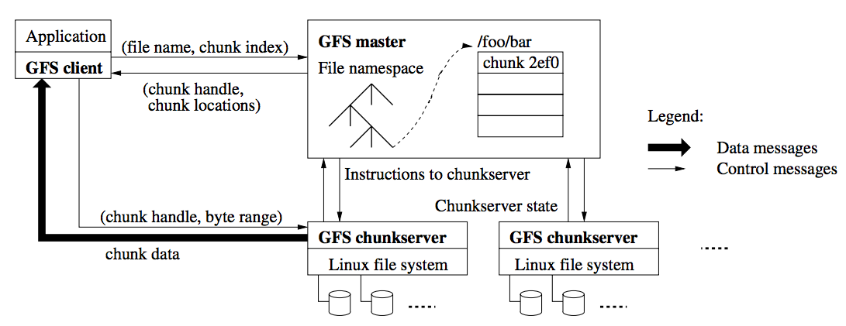
GFS: overview

Slide 34
GFS: replication
Chunkmaster
Backup
Client
Primary
Backup

Slide 35
GFS: replication
Chunkmaster
Backup
Client
Primary
Backup
Challenge due to large writes: high latency when writing to distant primary
How to optimize write performance?

Slide 36
GFS: replication
Chunkmaster
Backup
Client
Primary
Backup
Challenge due to large writes: high latency when writing to distant primary
How to optimize write performance?

Slide 37
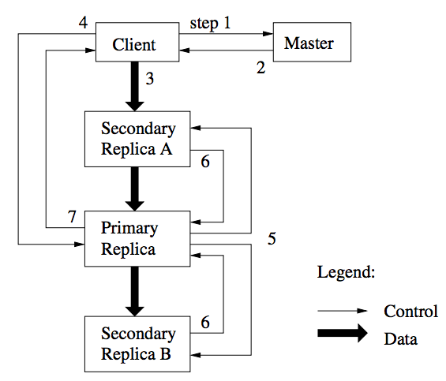
GFS: data flow vs. control flow

Slide 38
GFS: data flow vs. control flow

Slide 39
GFS: handling server failures
Chunkmaster grants 60 second leases to primary
Utility of lease?
What if lease expires in the midst of a write?
Primary must renew lease
New version number upon lease renewal
Replicas locally log version number (helps detect stale replicas)

Slide 40
GFS: handling server failures
Chunkmaster grants 60 second leases to primary
Utility of lease?
What if lease expires in the midst of a write?
Primary must renew lease
New version number upon lease renewal
Replicas locally log version number (helps detect stale replicas)
Store checksums to detect corrupted data

Slide 41
Next time…
Paxos-based RSM

